Slide 1
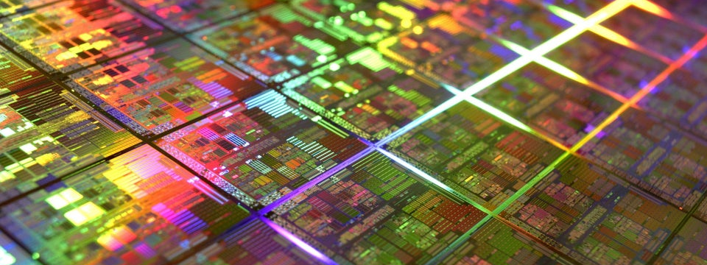
Slide Deck 16
ECE 4203 VLSI Design

Slide 2
Midterm 2 Overview
Covers topics after Midterm #1
Four (4) Questions (adding up to 100 points)
Sequential circuit
Power consumption
Interconnect
Logical Path Effort
No Questions on
PLL, DLL’s
I/O
SPICE simulation
Thermal management, packaging
Extra Credit Question
Debugging latch error as your first project at NVIDIA

Slide 3
Multistage Logic Networks
Logical effort generalizes to multistage networks
Path Logical Effort
Path Electrical Effort
Path Effort

Slide 4
Branching Effort
Introduce branching effort
Accounts for branching between stages in path
Now we compute the path effort
F = GBH
Note:

Slide 5
Multistage Delays
Path Effort Delay
Path Parasitic Delay
Path Delay

Slide 6
Designing Fast Circuits
Delay is smallest when each stage bears same effort
Thus minimum delay of N stage path is
This is a key result of logical effort
Find fastest possible delay
Doesn’t require calculating gate sizes

Slide 7
Gate Sizes
How wide should the gates be for least delay?
Working backward, apply capacitance transformation to find input capacitance of each gate given load it drives.
Check work by verifying input cap spec is met.

Slide 8
Example: 3-stage path
Select gate sizes x and y for least delay from A to B

Slide 9
Example: 3-stage path
Logical Effort G = (4/3)*(5/3)*(5/3) = 100/27
Electrical Effort H = 45/8
Branching Effort B = 3 * 2 = 6
Path Effort F = GBH = 125
Best Stage Effort
Parasitic Delay P = 2 + 3 + 2 = 7
Delay D = 3*5 + 7 = 22 = 4.4 FO4

Slide 10
Example: 3-stage path
Work backward for sizes
y = 45 * (5/3) / 5 = 15
x = (15*2) * (5/3) / 5 = 10

Slide 11
Timing Diagrams
Contamination and Propagation Delays
t_{pd} | Logic Prop. Delay
t_{cd} | Logic Cont. Delay
t_{pcq} | Latch/Flop Clk->Q Prop. Delay
t_{ccq} | Latch/Flop Clk->Q Cont. Delay
t_{pdq} | Latch D->Q Prop. Delay
t_{cdq} | Latch D->Q Cont. Delay
t_{setup} | Latch/Flop Setup Time
t_{hold} | Latch/Flop Hold Time

Slide 12
Max-Delay: Flip-Flops

Slide 13
Min-Delay: Flip-Flops

Slide 14
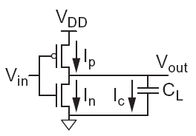
Charging a Capacitor
When the gate output rises
Energy stored in capacitor is
But energy drawn from the supply is
Half the energy from V_{DD} is dissipated in the pMOS transistor as heat, other half stored in capacitor
When the gate output falls
Energy in capacitor is dumped to GND
Dissipated as heat in the nMOS transistor

Slide 15
Activity Factor
Suppose the system clock frequency = f
Let f_{sw} = αf, where α = activity factor
If the signal is a clock, α = 1
If the signal switches once per cycle, α = ½
Dynamic power:

Slide 16
Dynamic Power Example
1 billion transistor chip
50M logic transistors
Average width: 12 λ
Activity factor = 0.1
950M memory transistors
Average width: 4 λ
Activity factor = 0.02
1.0 V 65 nm process
C = 1 fF/μm (gate) + 0.8 fF/μm (diffusion)
Estimate dynamic power consumption @ 1 GHz. Neglect wire capacitance and short-circuit current.

Slide 17
Solution

Slide 18
Wire RC Delay
Estimate the delay of a 10x inverter driving a 2x inverter at the end of the 1 mm wire. Assume wire capacitance is 0.2 fF/mm and that a unit-sized inverter has R = 10 KW and C = 0.1 fF.
t_{pd} = (1000 Ω)(100 fF) + (1000 + 800 Ω)(100 + 0.6 fF) = 281 ps

Slide 19
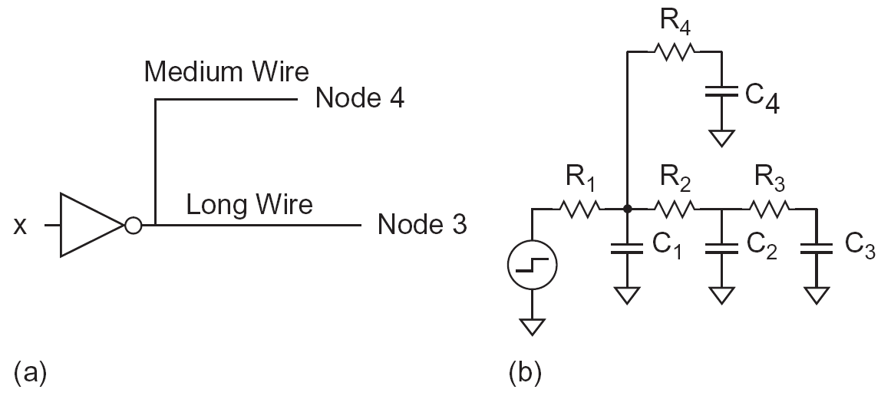
Elmore Delay

